Slide 1

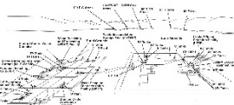
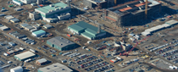
Template Guidelines
* Delete this page upon completion to restore page numbers
Font: Arial to be used throughout (use italics only for the titles of published works)
Bullets: Prefer two-tier bullet format; only use three when necessary
Sentence structure: Sentences should be short and concise when possible
Punctuation: Use periods only with multiple sentences
Tables: Match Hanford color scheme when possible; options are located under Design tab for tables (examples to the right)
Graphic images: 1.5-pt blue borderline, no shadows (example below left)
Photos: May have slight shadow (optional) but no borderlines; make your choice consistent throughout
Dates: Required on photos and graphics when possible. Dates should be 10-pt Arial Bold and be located on the bottom left of the photo or graphic when possible (example below right).
Captions: Should be12-pt Arial (left justified) and consistent throughout document
10-pt Arial Bold white inside a black box at 45% transparency
Before/After and/or Dates
Before/After and/or Dates

Slide 2
100-H North Rebound Study
Data and Model Performance Evaluation
Hai Pham, Michelle Pedrazas, Robin Weatherl, and Greg Ruskauff
February 20, 2024

Slide 3
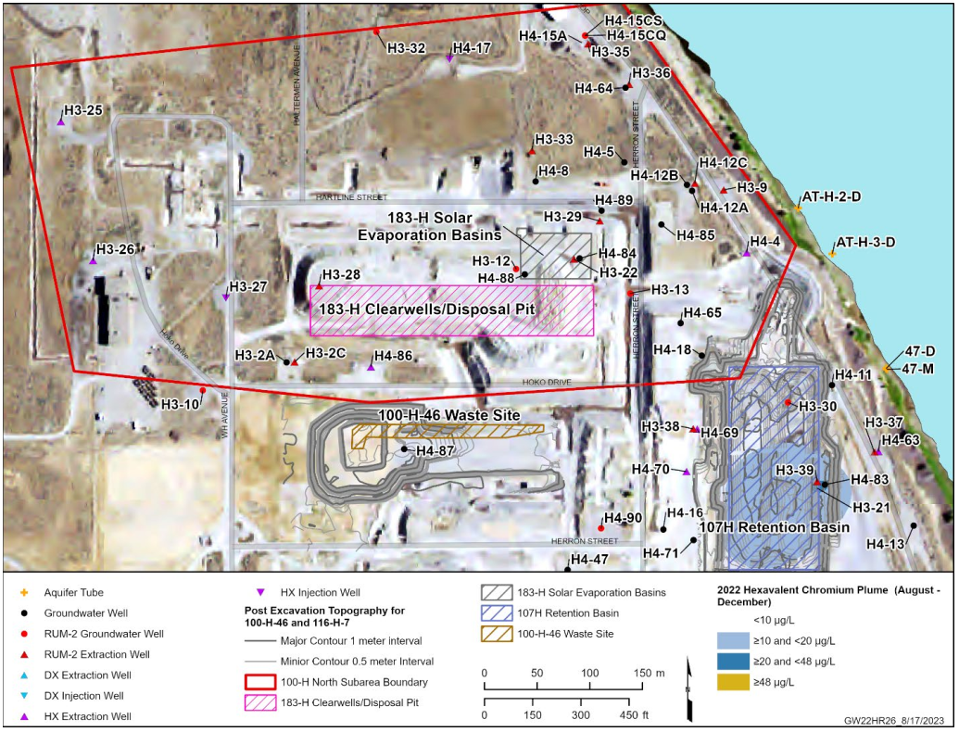
Background
Rebound study initiated on October 4, 2022, in accordance with DOE/RL-2021-23-ADD1, Groundwater Monitoring Plan for the 100-H North Subarea Rebound Study (100-HR-3 Operable Unit).
Objectives:
To evaluate the effectiveness of current remediation activity in meeting contaminant cleanup targets by observing contaminant dynamics under ambient environmental conditions
To evaluate the impact of the periodically rewetted zone (PRZ) on contaminant concentrations.
To evaluate model performance during rebound study period
Evaluated for trends that may occur due to pump and treat (P&T) system shutdown and plume migration, such as the impact of groundwater level fluctuations on groundwater concentrations near waste sites.
Source: DOE/RL 2022 40, Hanford Site Groundwater Monitoring Report for 2022.
100 H North Subarea Boundary with Unconfined Aquifer Monitoring Locations

Slide 4
Background
Monitoring Wells at the 100‑H North Subarea
Well Name | Well Type | Went Offline
199‑H3‑25 | Extraction | 05/2022
199‑H3‑26 | Extraction | 04/2022
199‑H3‑27 | Injection | 08/2022
199‑H3‑2A | Monitoring | NA
199‑H4‑12A | Monitoring | NA
199‑H4‑15A* | Extraction | 08/2022
199‑H4‑17 | Injection | 06/2021
199‑H4‑18 | Monitoring (formerly injection) | 07/2018
199‑H4‑4 | Extraction | 09/2022
199‑H4‑5 | Monitoring | N/A
199‑H4‑64* | Extraction | 05/2021
199‑H4‑65 | Monitoring | N/A
199‑H4‑8 | Monitoring | N/A
199‑H4‑84 | Monitoring | N/A
199‑H4‑85 | Monitoring | N/A
199‑H4‑86 | Extraction | 11/2022
199‑H4‑88 | Monitoring | N/A
199‑H4‑89 | Monitoring | N/A
Four extraction wells (199-H3-25, 199-H3-26, 199-H4-86, and 199-H4-4) and two injection wells (199-H3-27 and 199-H4-17) in the unconfined aquifer were turned off as part of the rebound study.
In addition, 10 monitoring wells, and 6 aquifer tubes were sampled at either a monthly or bi-monthly frequency for Cr(VI).
*199-H4-15A and *199-H4-64 extraction wells went offline too but are not part of the rebound study.
This table lists the wells that were sampled during the rebound study. In bold, the system wells that went offline as part of the rebound study.

Slide 5
100-HR-3 GWFTM
Using the existing 100-HR-3 groundwater flow and transport model (GWFTM) to simulate flow and Cr(VI) transport at waste sites in the 100-H North Subarea
Extended temporal discretization for calibration model until October 2023
Calibration Period
Post-calibration Period
Rebound Study Period
Jan 2014 – Dec 2020
Jan 2021 – Oct 4, 2022
Oct 4, 2022 - Oct 2023
Evaluated performance of the 100-HR-3 GWFTM during the rebound study period by analyzing the agreement between observed and simulated water level and concentration data.
Evaluated for trends that may occur due to pump and treat (P&T) system shutdown and plume migration, such as the impact of groundwater level fluctuations on groundwater concentrations near waste sites.

Slide 6
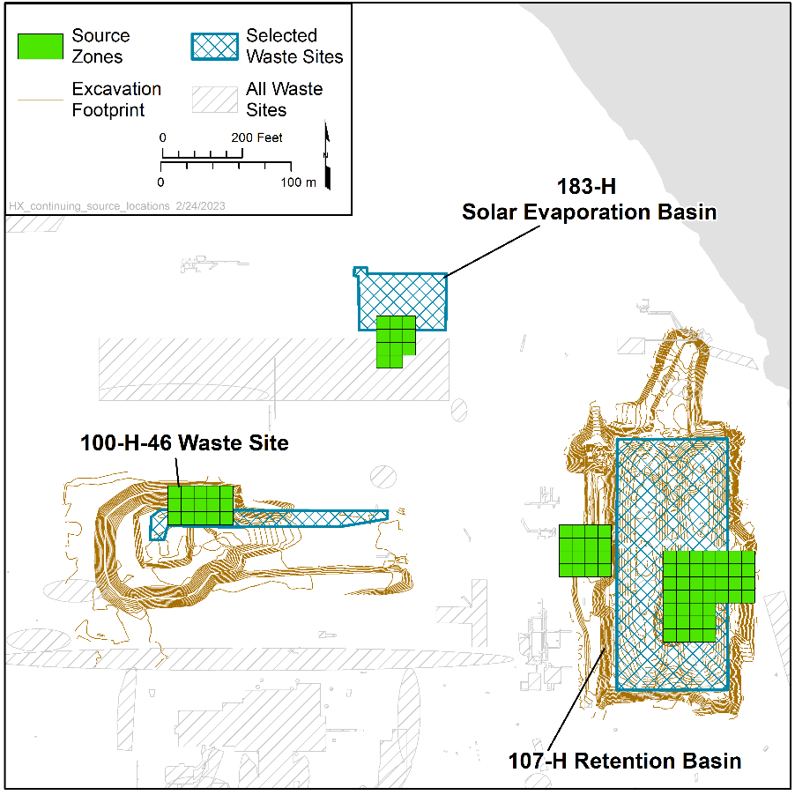
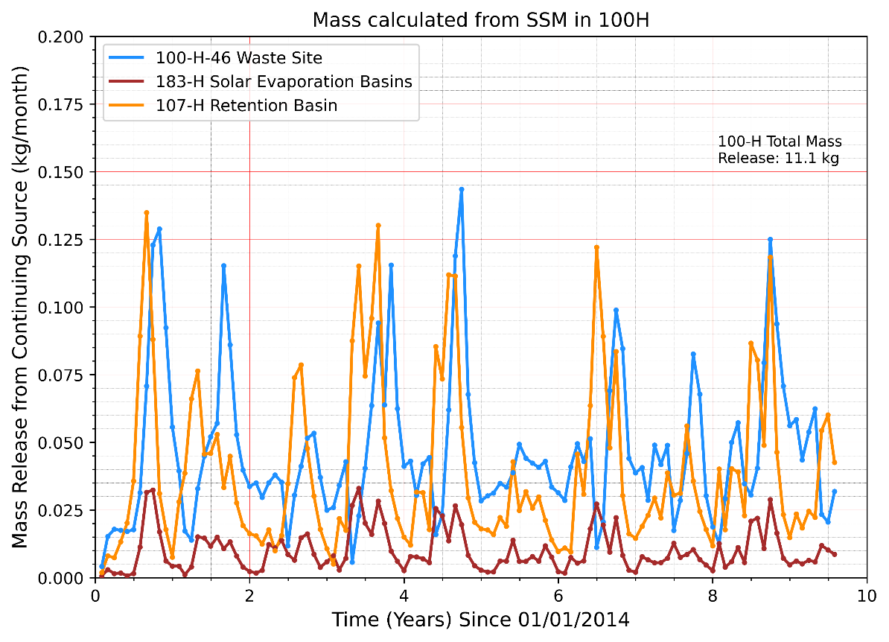
Cr(VI) Continuing Sources
In SGW-64372, 100 D/H Continuing Hexavalent Chromium Source Evaluation:
183-H-SEB and 100-H-46 Waste Site are both identified as secondary sources located within the 100-H North Subarea.
Rebound studies were recommended to be conducted at both sites.
100-H-46 Waste Site is the strongest source in the 100-H Subarea:
Continuing Source Locations in the 100-H Area Source: ECF‑100HR3‑22‑0119, Predictive Contaminant Transport Simulation with the 100‑HR‑3 GWFTM for the Continuing Source Evaluation No Further Action Scenario.

Slide 7
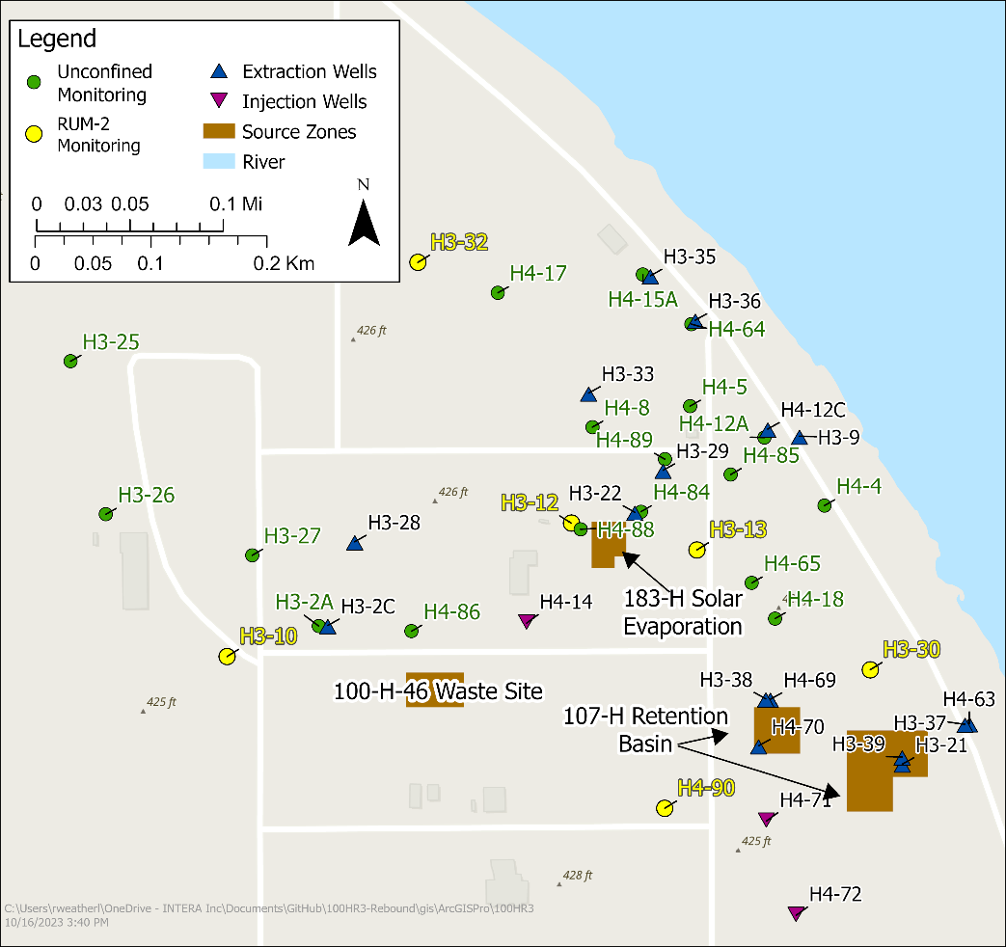
Results
Three main techniques were used to analyze the observed and simulated data:
Time series of monthly averaged water level and Cr(VI) concentration data → insights into correlation between groundwater fluctuations and contaminant release
Residual plots to assess agreement between observed and simulated water level data → insights into model performance
Plume maps depicting simulated concentration of Cr(VI) in the unconfined aquifer → insights into spatial and temporal plume behavior
Map with wells and continuing sources in 100-H

Slide 8
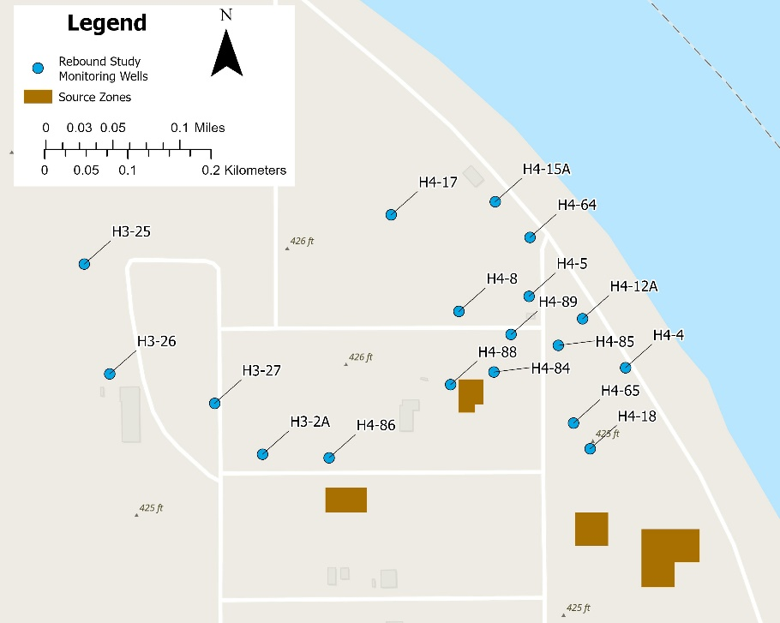
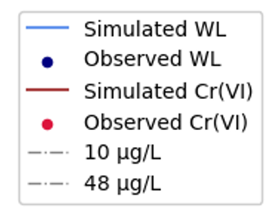
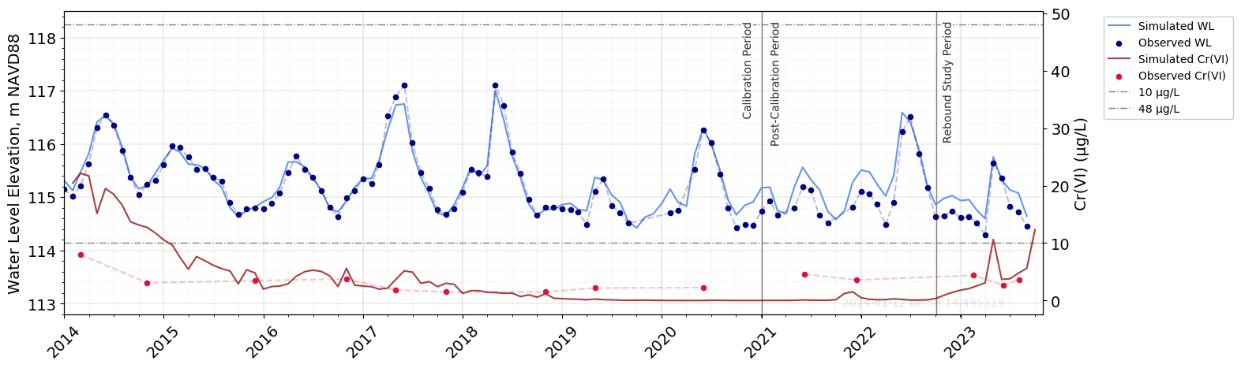
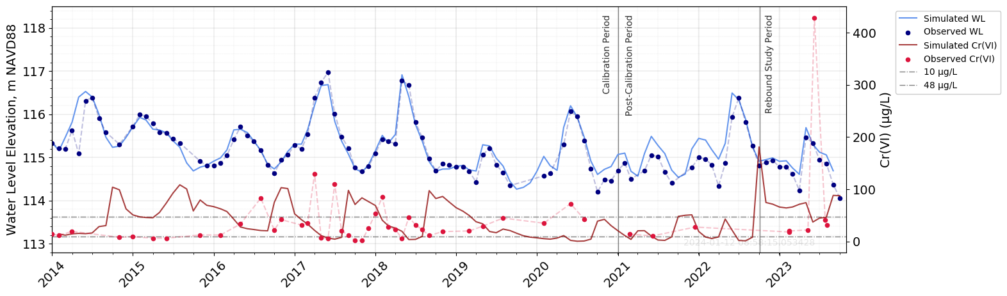
WLs and Concentrations
Wells near 183‑H SEB Waste Site
Well 199‑H4‑8: Both observed and simulated concentration values remain <= 10 µg/L.
Well 199‑H4‑84:
This well is located downgradient of 183‑H SEB and approx. 200 m from riverside.
Model simulated Cr(VI) > 48 µg/L for nearly entire rebound study period. 4/5 observed concentrations in rebound period are only > 10 µg/L.
A 428 µg/L sample collected in June 2023, but not captured by model. This value is 10x higher than the second highest concentration recorded at this well.
It is most likely this value was a short sudden release measured due to grab sampling. Is it possible that the 100‑H‑46 waste site is contributing to this peak value too?
Monthly‑Averaged Water‑Level and Cr(VI) Data for Well 199‑H4‑8
Monthly‑Averaged Water‑Level and Cr(VI) Data for Well 199‑H4‑84

Slide 9
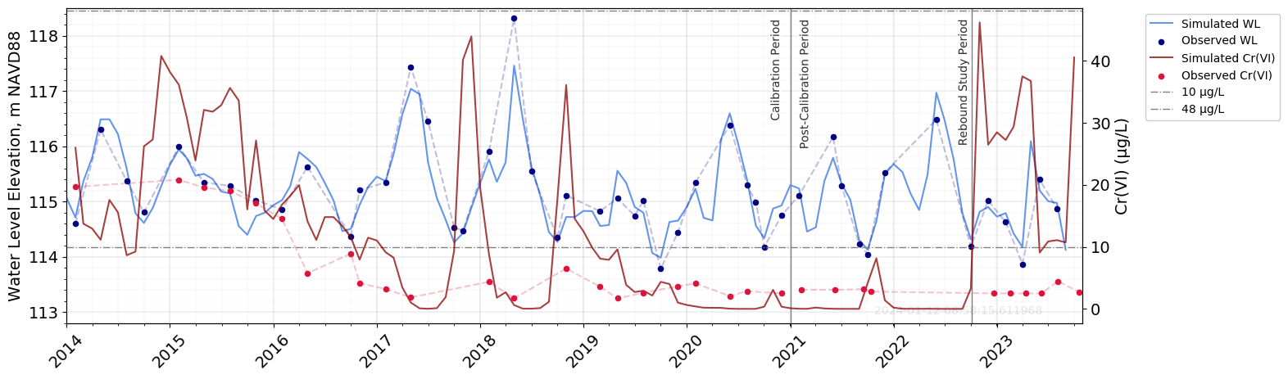
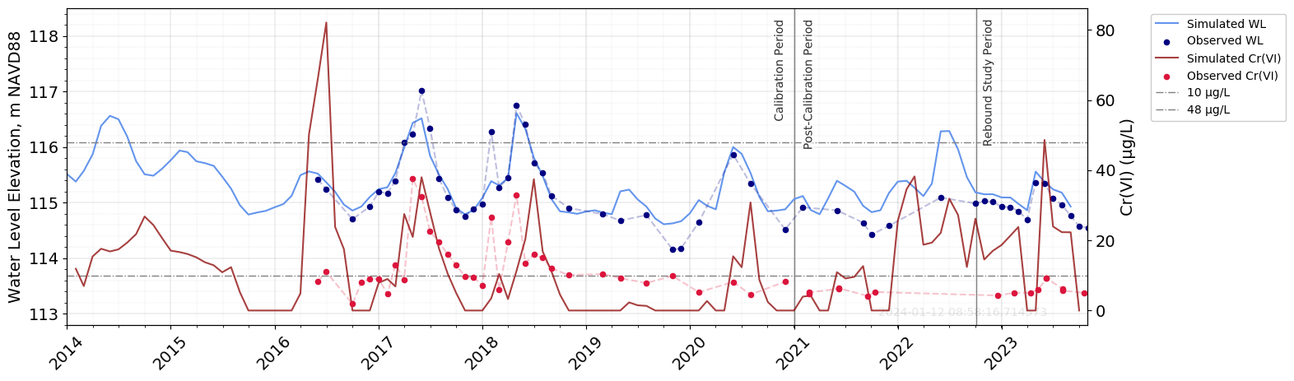
WLs and Concentrations
Wells near 183‑H SEB Waste Site
Wells 199‑H4‑85, and 199‑H4‑88: Simulated Cr(VI) is generally higher than what is measured during rebound study period: simulated concentrations > 10 µg/L, whereas observations generally < 10 ug/L.
Monthly‑Averaged Water‑Level and Cr(VI) Data for Well 199‑H4‑85
Monthly‑Averaged Water‑Level and Cr(VI) Data for Well 199‑H4‑88

Slide 10
WLs and Concentrations
In general:
Model simulations of water levels tend to reasonably capture observed values, with a slight tendency for model to overpredict observed values after the calibration period.
Concentrations increase after WLs increase, which agrees with the conceptual site model (CSM) of the continuing sources.
Magnitude and lag between concentration peaks and water‑level peaks depends primarily on distance of each monitoring well to Columbia River and waste sites, as well as on the source calibration.
Wells with a higher density of observations (i.e., wells part of AWLN network) tend to be better calibrated. Thus, a greater agreement with new observations is evident.
Divergence between observations and simulations is more significant for concentrations.

Slide 11
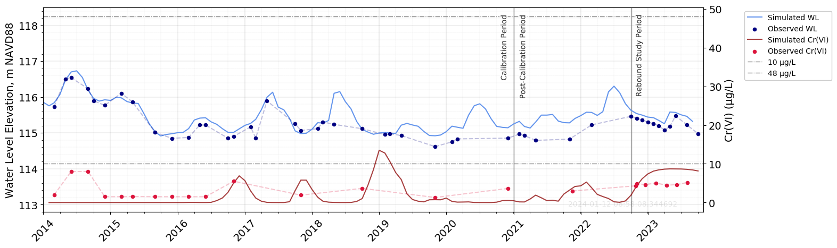
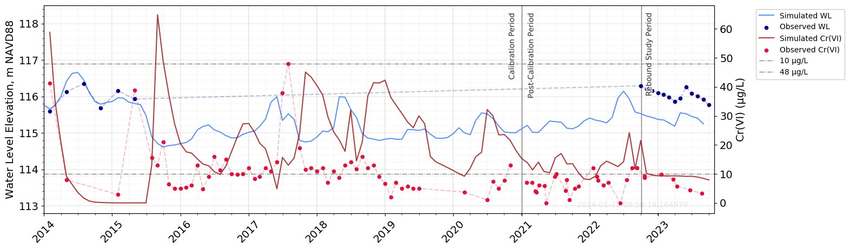
WLs and Concentrations
Wells near 100-H-46 Waste Site
Simulated and observed concentrations are generally < 48 µg/ for the entire timespan, and <= 10 µg/L during rebound study period.
Well 199‑H3‑2A: Simulated WLs and concentrations slightly surpass observed values during rebound study period.
Well 199‑H4‑86: Observed WLs consistently surpass simulated values. This outcome is unsurprising, considering the limited data available during the model calibration. There is good agreement between simulated and observed concentrations.
The 100‑H‑46 waste site and nearby wells are relatively farther from the riverside when compared to the 183‑H SEB waste site and its associated wells, leading to smaller water table fluctuations.
Monthly‑Averaged Water‑Level and Cr(VI) Data for Well 199‑H3‑2A
Monthly‑Averaged Water‑Level and Cr(VI) Data for Well 199‑H4‑86

Slide 12
Residual Plots
$$Residual = Observed – Simulated$$
In general, there is a higher number of observations (thus residuals) collected at low stage than high stage, particularly during the post-calibration and rebound study periods.
Negative residuals at low stage and positive residuals at high stage indicate overestimating and underestimating at the extremes, while residuals linger around 0 m during average stage conditions.
The random and scattered residuals during average stage conditions suggest the model can capture these observations, however, the systematically higher and lower residuals at extremes suggest that the model fails to capture peaks and troughs.

Slide 13
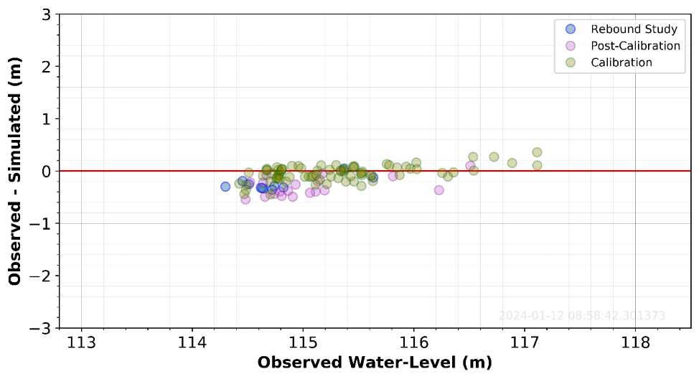
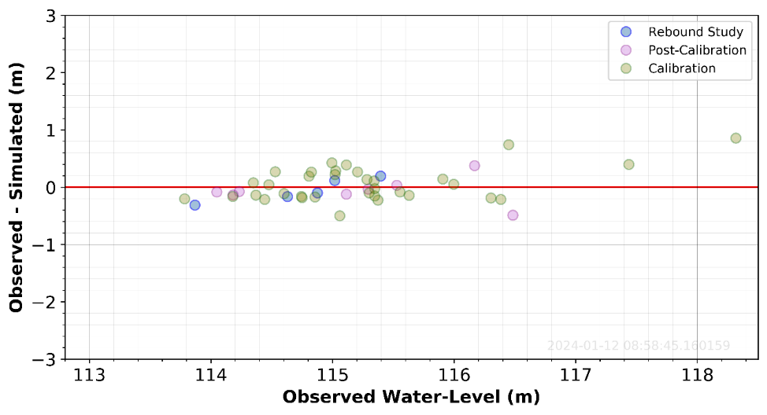
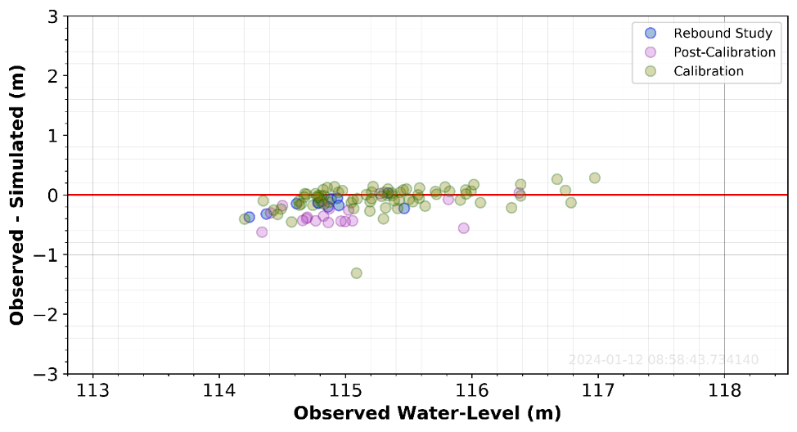
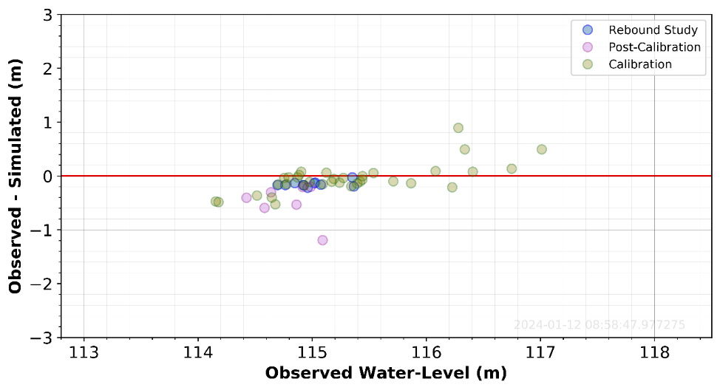
Residual Plots
Wells near 183-H SEB Waste Site
Wells 199‑H4‑8 and 199‑H4‑84 display many residuals within the 0.25 m range
Well 199‑H4‑85 shows random and scattered residuals, indicating a well‑fitted model, with only a few residuals exceeding 0.5 m.
Well 199‑H4‑88 display more outliers, with a couple of residuals at 1 m.
Residual Plot of Observed and Simulated Water Levels for Well 199‑H4‑8
Residual Plot of Observed and Simulated Water Levels for Well 199‑H4‑85
Residual Plot of Observed and Simulated Water Levels for Well 199‑H4‑84
Residual Plot of Observed and Simulated Water Levels for Well 199‑H4‑88

Slide 14
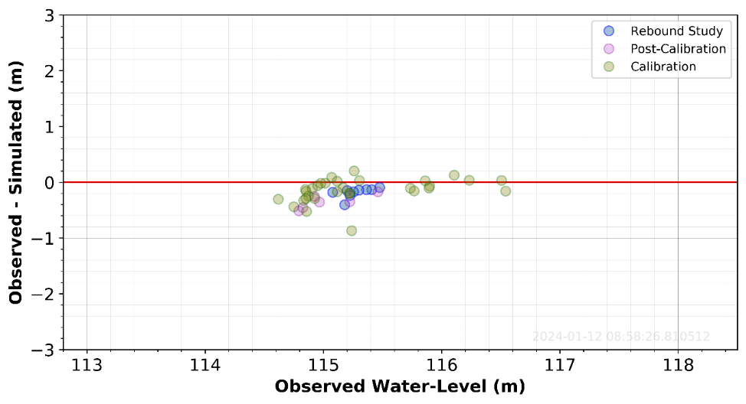
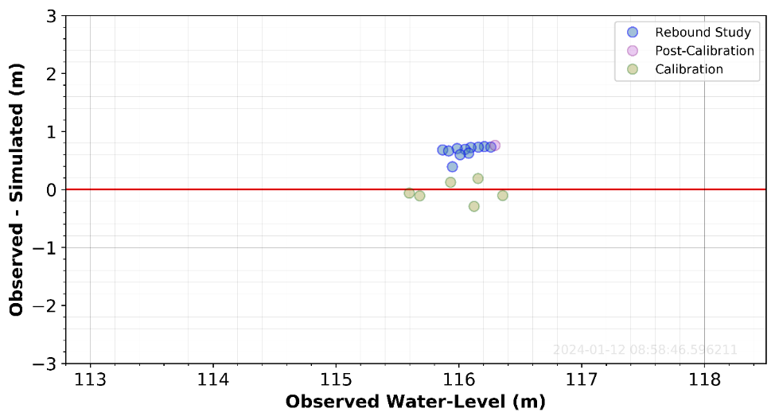
Residual Plots
Wells near 100-H-46 Waste Site
Residual Plot of Observed and Simulated Water Levels for Well 199‑H3‑2A
Residual Plot of Observed and Simulated Water Levels for Well 199‑H4‑86
Residuals for well 199-H3-2A show a random and scattered distribution close around the 0 m line.
The negative residuals at lower WLs suggest the model overestimates the low WLs at this well.
Well 199-H4-86 has fewer number of observations, and thus residuals.
The model performs reasonably well during the calibration period yet underestimates WLs in the post-calibration and rebound study periods.

Slide 15
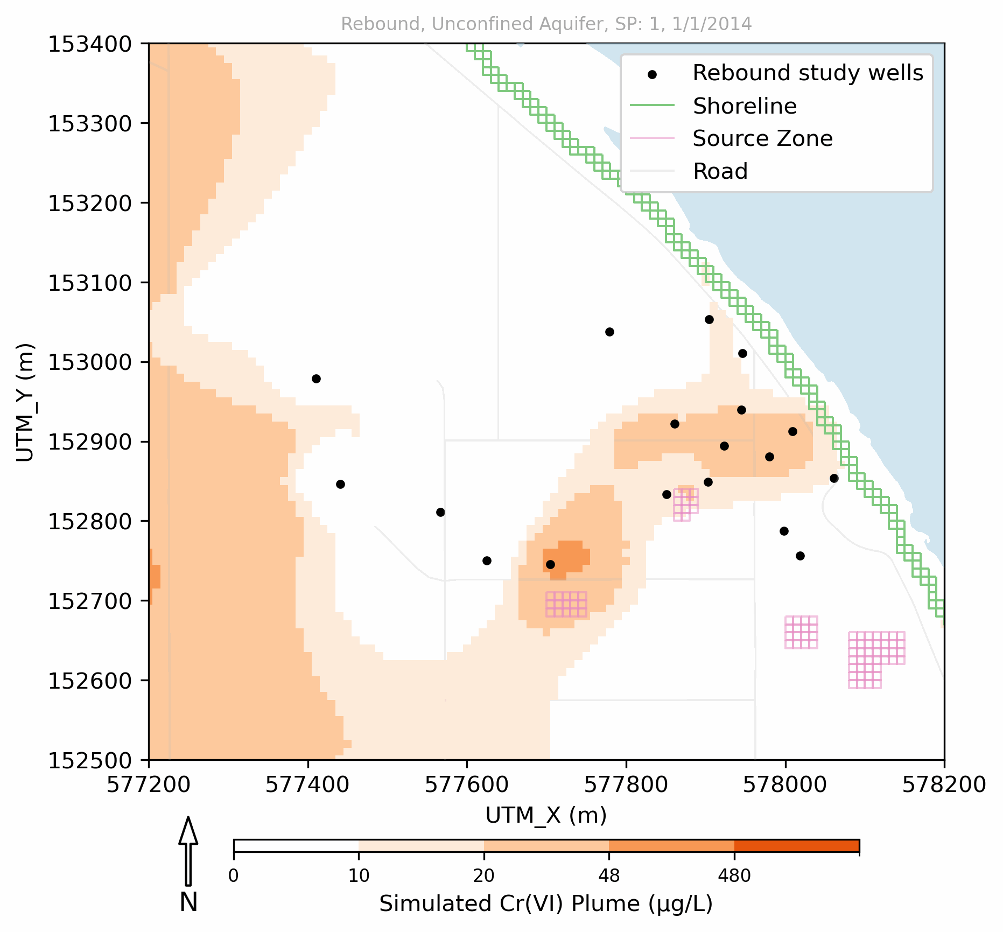
Plume Migration
Simulated Plume Extents in the Unconfined Aquifer
Contaminant plumes show an overall decrease in spatial extent, yet an increase in concentrations, particularly downgradient of continuing sources.
Plumes migrate northeast toward river, with concentrations > 48 ug/L in proximity to waste sites (1 model cell at waste sites > 480 ug/L at low and high river stage conditions).
The plume from 100-H-46 WS has moved toward and overlapped plume that originates from 183-H SEB waste site. The plume from 100-H-46 is larger and more persistent than that from 183-H SEB and is essentially unconstrained except at the northern edge by well 199-H4-86.
H4-64
H4-88
H4-84
183-H-SEB
H4-86
100-H-46 Waste Site

Slide 16
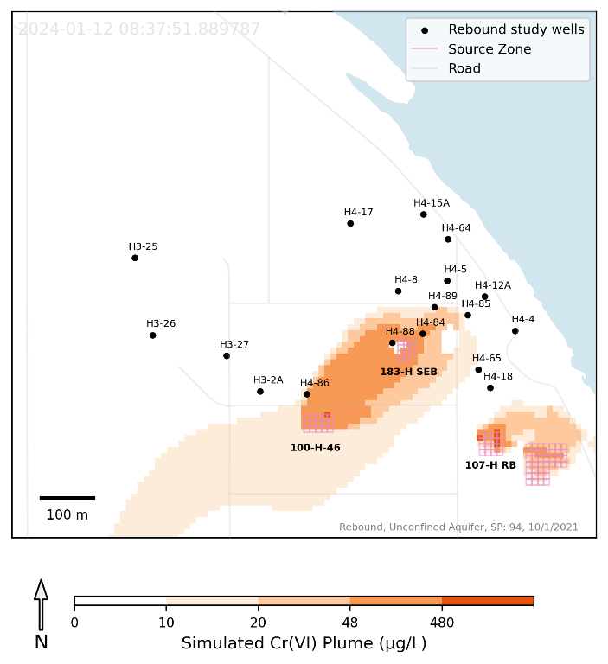
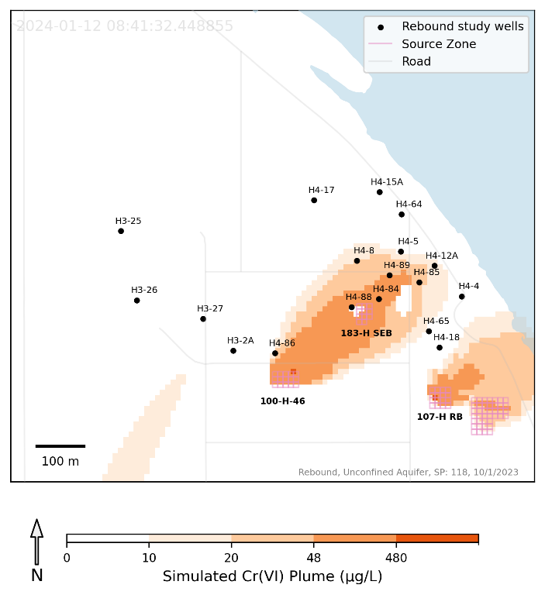
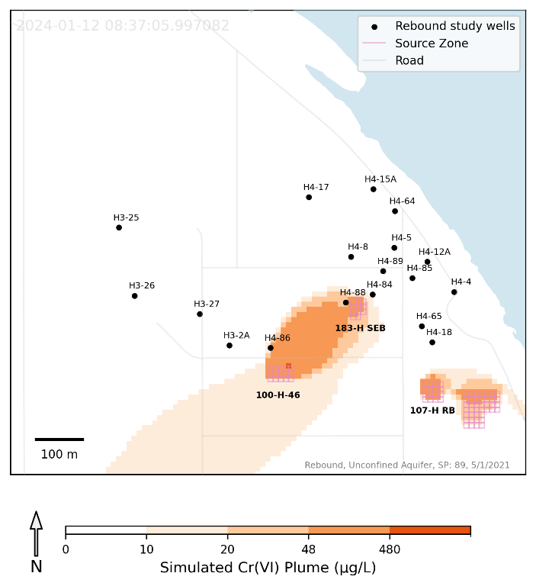
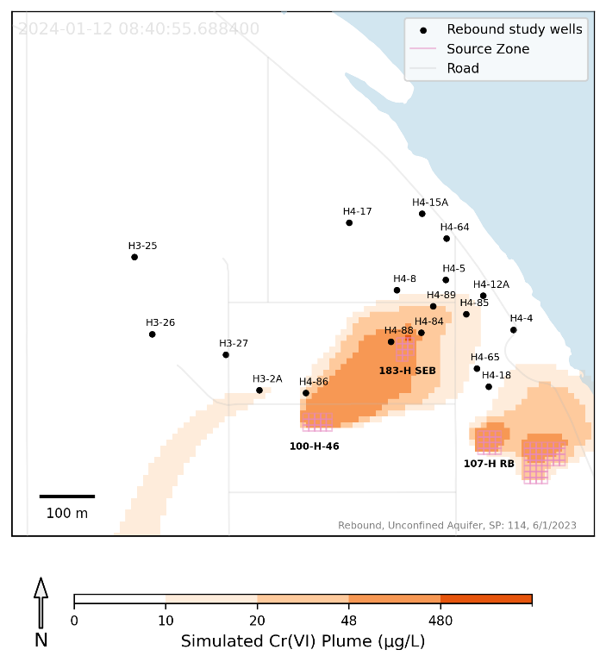
Plume Migration
Simulated Plume Extents in the Unconfined Aquifer During Low River Stage: (Left) October 2021 and (Right) October 2023
Simulated Plume Extents in the Unconfined Aquifer During High River Stage: (Left) May 2021 and (Right) June 2023
Contaminant plumes show an overall decrease in spatial extent, yet an increase in concentrations, particularly downgradient of continuing sources.
Plumes migrate northeast toward river, with concentrations > 48 ug/L in proximity to waste sites (1 model cell at waste sites > 480 ug/L at low and high river stage conditions).
The plume from 100-H-46 WS has moved toward and overlapped plume that originates from 183-H SEB waste site. The plume from 100-H-46 is larger and more persistent than that from 183-H SEB and is essentially unconstrained except at the northern edge by well 199-H4-86.

Slide 17
Conclusion
Overall, most monitoring wells indicate decreasing concentrations in unconfined aquifer during rebound study period, with values <48 ug/L, often falling <10 ug/L. Thus, remediation activities are generally aligning with cleanup goals.
The model falls short of capturing peaks and troughs observed in data, as seen in residual plots. The model tends to underestimate observations in the calibration period and overestimate observations in the post-calibration and rebound study periods.
Well 199-H4-84, positioned downstream of 183-H SEB waste site, has a very high Cr(VI) peak in June 2023. Model fails to capture this peak.
This well is likely impacted by contamination from 183-H SEB WS, and as the simulation suggests, by contamination from the 100-H-46 WS too. However, little data exists to assess this result, so contribution from 100-H-46 should be considered highly uncertain.
The discrepancy between observed and simulated concentration values could stem from:
monthly stress periods in model may lack the granularity needed to capture short-term dynamics crucial to the PRZ CSM.
current grid cell resolution (10 by 10 m) might not adequately represent individual wells.

